Slide 1
Notes from Ouykhy
Mention the Colombian version
Use “Banana”, “data ana”, “^_^” as an examples

Slide 2
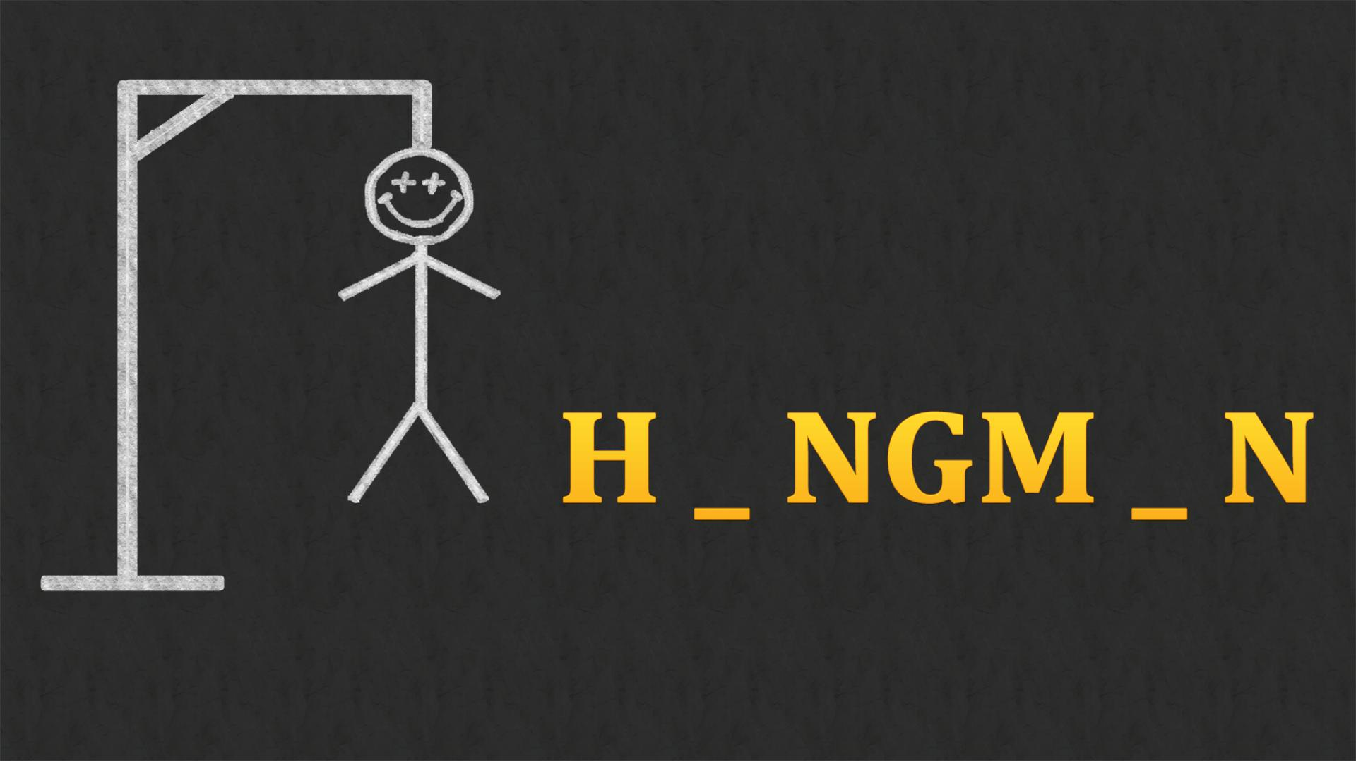

Slide 3
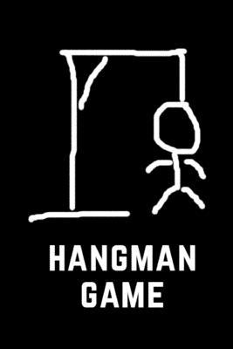
Hangman game Maher Zeghida Ana Cortes Ouykhy Quach

Slide 4
Challenges
Requirements and rules we decided:
2 players only ( 1 host and 1 player to guess)
Player guessing is allowed to 6 errors before end (burning the man)
Only take letters as input and a letter can’t be inputted twice
The drawing and dashes – but Yoda Ana rocks!!

